Slide 1
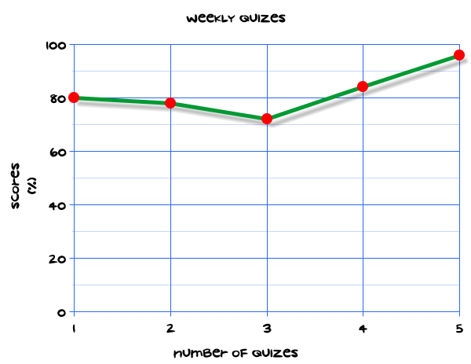
My Statistics Interactive Notebook
Name
Class
Teacher
Term 1 Semester 1
1

Slide 2
Create your own front page
It needs to contain the following –
My number interactive notebook
Name
Class
Teachers Name
Semester 1 Term 1
Page number 1

Slide 3
Contents
Glossary or Formula Page
Page
Date
Description
2
3

Slide 4
Tasks
24
7
30
Essential Question
Questions
Notes
Summary
4
5

Slide 5
24
7
30
Date
Title
EQ –
5

Slide 6
24
7
30
Date
Comparing data
EQ –
Name four types of statistical data displays and explain whether they are best suited for displaying the data or analysing it.
5

Slide 7
24
7
30
Date
Comparing data
EQ –
Name four types of statistical data displays and explain whether they are best suited for displaying the data or analysing it.
What are the different ways of displaying statistical data?
5

Slide 8
24
7
30
Date
Comparing data
EQ –
Name four types of statistical data displays and explain whether they are best suited for displaying the data or analysing it.
What are the different ways of displaying statistical data?
Circle or Pie Graphs: Give an excellent impression of overall relationships between different aspects of statistical information. In a circle graph, the angles of the sectors show the parts of a total amount.
5

Slide 9
24
7
30
Date
Comparing data
EQ –
Name four types of statistical data displays and explain whether they are best suited for displaying the data or analysing it.
What are the different ways of displaying statistical data?
Circle or Pie Graphs: Give an excellent impression of overall relationships between different aspects of statistical information. In a circle graph, the angles of the sectors show the parts of a total amount.
Bar charts, column graphs and line graphs: Can be read quite accurately, so they are useful for making predictions or finding precise relationships
5

Slide 10
24
7
30
Date
Comparing data
EQ –
Name four types of statistical data displays and explain whether they are best suited for displaying the data or analysing it.
What are the different ways of displaying statistical data?
Circle or Pie Graphs: Give an excellent impression of overall relationships between different aspects of statistical information. In a circle graph, the angles of the sectors show the parts of a total amount.
Bar charts, column graphs and line graphs: Can be read quite accurately, so they are useful for making predictions or finding precise relationships
Histograms: Used to show frequencies of grouped data.
5

Slide 11
24
7
30
Date
Comparing data
EQ –
Name four types of statistical data displays and explain whether they are best suited for displaying the data or analysing it.
What are the different ways of displaying statistical data?
Circle or Pie Graphs: Give an excellent impression of overall relationships between different aspects of statistical information. In a circle graph, the angles of the sectors show the parts of a total amount.
Bar charts, column graphs and line graphs: Can be read quite accurately, so they are useful for making predictions or finding precise relationships
Histograms: Used to show frequencies of grouped data.
Dot plots and stem-and-leaf plots: Used to get a quick idea of the nature of a distribution.
5

Slide 12
24
7
30
Date
Comparing data
EQ –
Name four types of statistical data displays and explain whether they are best suited for displaying the data or analysing it.
What are the different ways of displaying statistical data?
Circle or Pie Graphs: Give an excellent impression of overall relationships between different aspects of statistical information. In a circle graph, the angles of the sectors show the parts of a total amount.
Bar charts, column graphs and line graphs: Can be read quite accurately, so they are useful for making predictions or finding precise relationships
Histograms: Used to show frequencies of grouped data.
Dot plots and stem-and-leaf plots: Used to get a quick idea of the nature of a distribution.
Scatter plot (scatter graph): Used to show bivariate data, particularly where the variables could be related.
5

Slide 13
24
7
30
Date
Comparing data
EQ –
Name four types of statistical data displays and explain whether they are best suited for displaying the data or analysing it.
What are the different ways of displaying statistical data?
Circle or Pie Graphs: Give an excellent impression of overall relationships between different aspects of statistical information. In a circle graph, the angles of the sectors show the parts of a total amount.
Bar charts, column graphs and line graphs: Can be read quite accurately, so they are useful for making predictions or finding precise relationships
Histograms: Used to show frequencies of grouped data.
Dot plots and stem-and-leaf plots: Used to get a quick idea of the nature of a distribution.
Scatter plot (scatter graph): Used to show bivariate data, particularly where the variables could be related.
Boxplot: Used to show the spread of data.
5

Slide 14
24
7
30
Date
Comparing data
EQ –
Name four types of statistical data displays and explain whether they are best suited for displaying the data or analysing it.
Histograms: Used to show frequencies of grouped data.
What are the different ways of displaying statistical data?
Dot plots and stem-and-leaf plots: Used to get a quick idea of the nature of a distribution.
Scatter plot (scatter graph): Used to show bivariate data, particularly where the variables could be related.
Boxplot: Used to show the spread of data.
Back-to-back or side-by-side: Used to compare different
distributions.
5

Slide 15
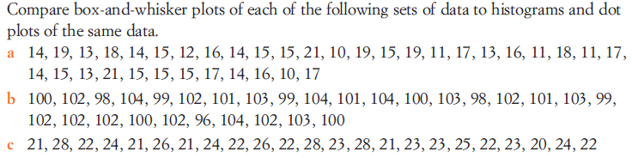
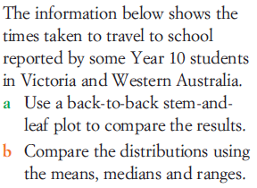

Task

Slide 16
Questions

Slide 17
Notes Review
24, 7 ,30
Date
Title
Essential question
Notes complete
Notes complete with colour and diagrams
Questions completed
Contents page filed in
Formula page filled in

Slide 18
Homework
Review your notes and write a summary answering the essential question.

